Slide 1
Multi-Strategy Trading Dashboard
Comparative Analysis of RSI, Moving Average Crossover, and Bollinger Bands Strategies Across 8 Financial Instruments
Ondřej Marvan

Slide 2
Introudction
THE PROBLEM
Traders struggle to choose the right strategy
Wrong choice = losses
RESEARCH QUESTION
"Which trading strategy performs best across different asset classes?"
WHY IT MATTERS
- Prevents costly trial-and-error
- Evidence-based trading decisions
- Strategy-asset matching

Slide 3
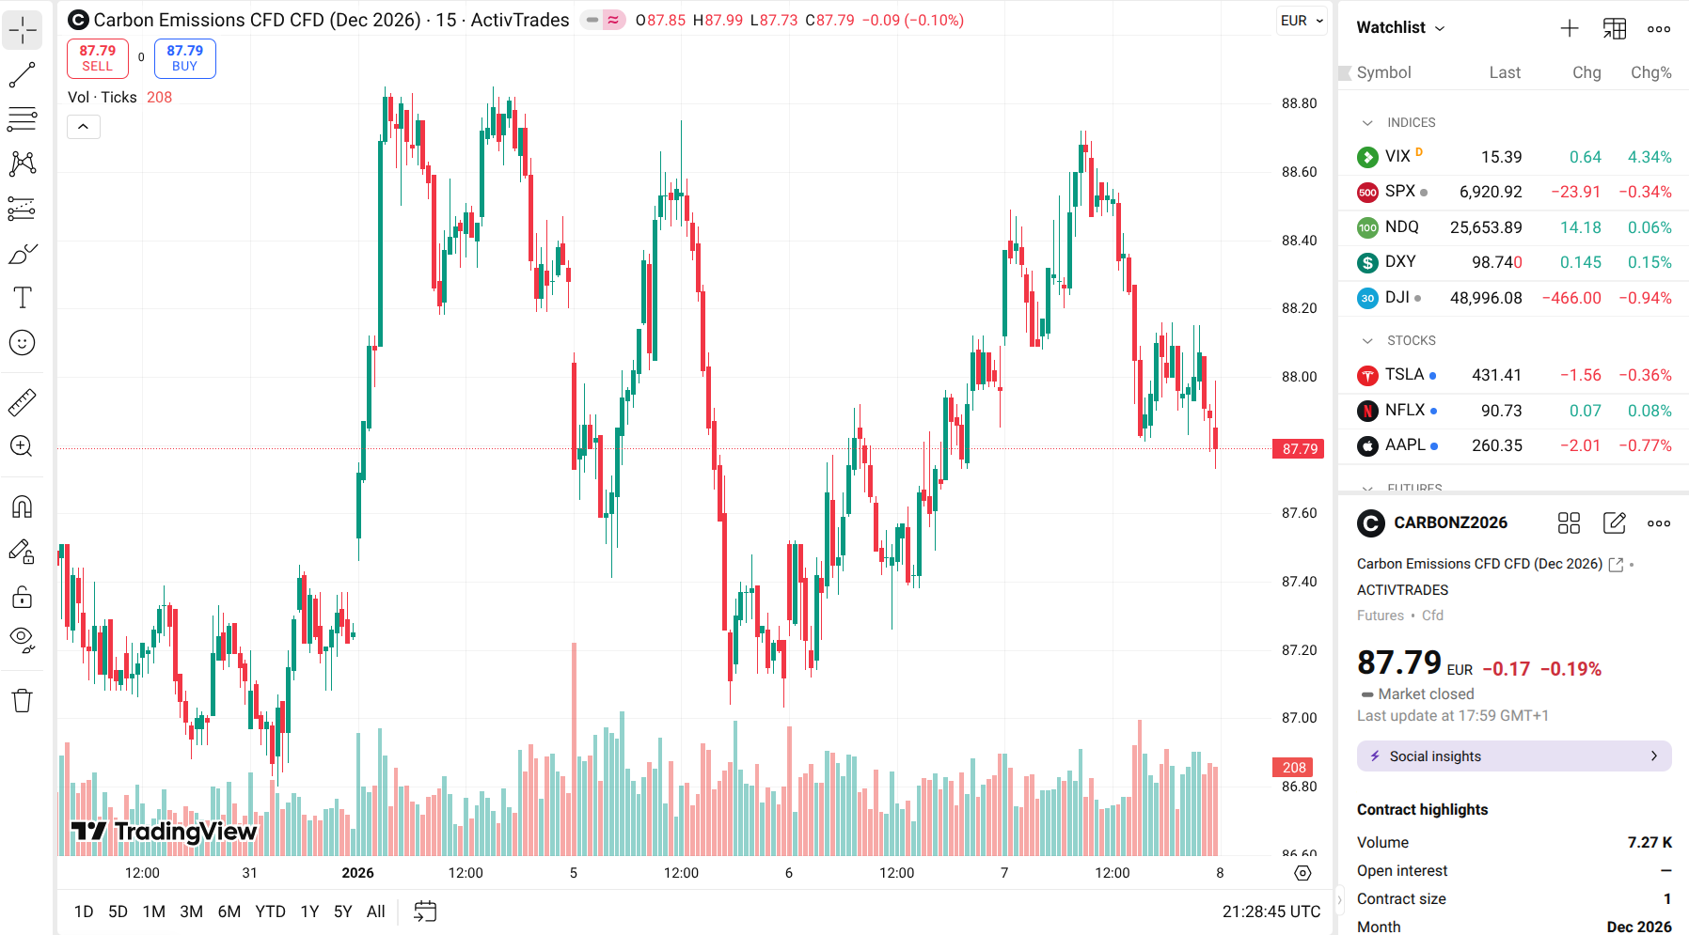
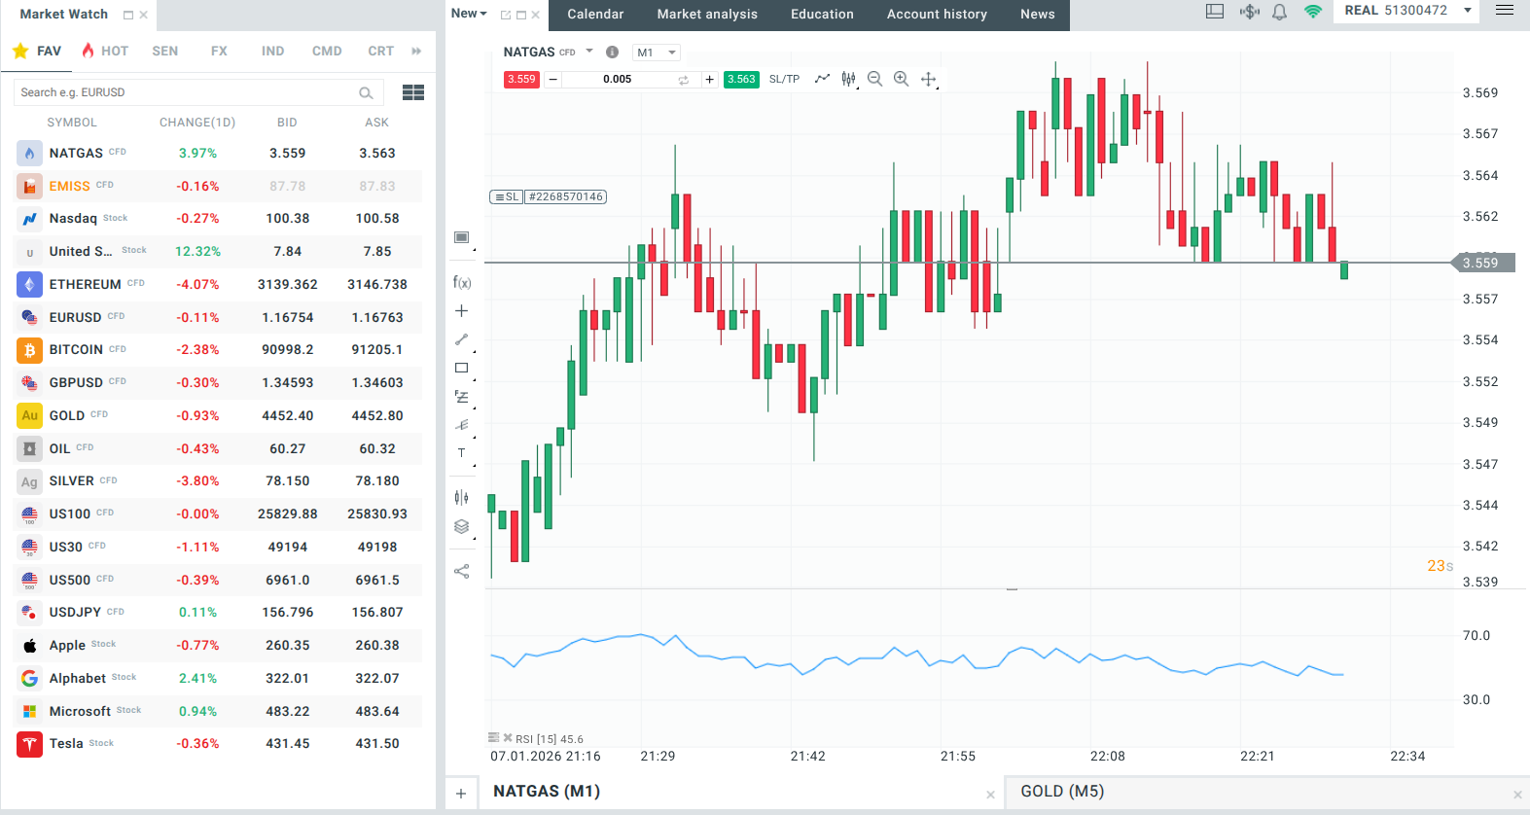
Paid backtesting
Lack of backtesting

Slide 4
Data Collection
8 INSTRUMENTS, 5 ASSET CLASSES
Environmental: EUA (EU “Emission” Allowance) - EUR
Energy: Oil, Natural Gas - USD
Precious Metals: Gold, Silver - USD
Cryptocurrency: Bitcoin - USD
Equity Indices: S&P 500, NASDAQ - USD
DATA SPECS
- Period: Jan 1 - Dec 31, 2025
- Daily OHLC + Volume
- 2,920 total records
- Cleaned with Pandas

Slide 5
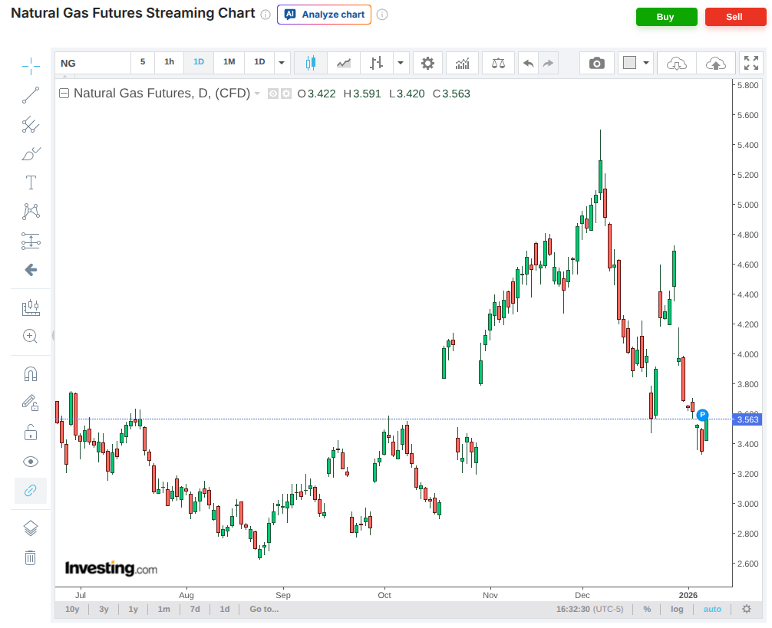
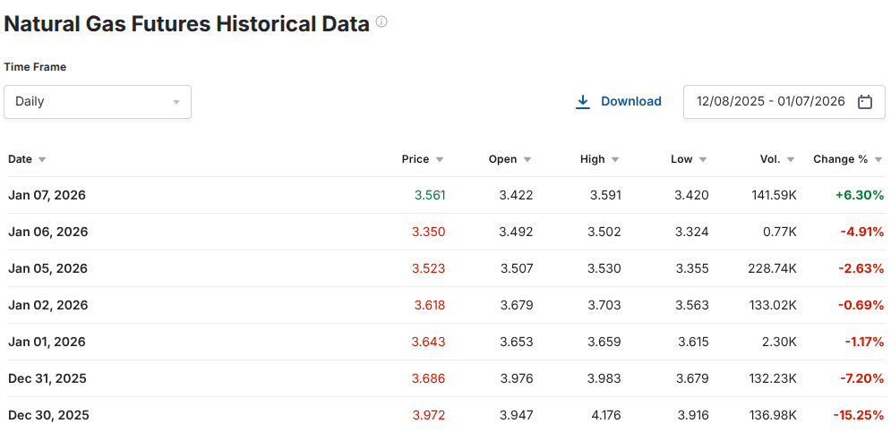

Slide 6
Technical Indicators
1. MOVING AVERAGES (SMA)
• 20, 50, 200-day averages
• Purpose: Identify trends
2. BOLLINGER BANDS
• 20-day average ± 2 std deviations
• Purpose: Measure volatility extremes
3. RSI (Relative Strength Index)
• 0-100 momentum scale
• <30 = Oversold, >70 = Overbought
• Purpose: Find reversal points

Slide 7
Three Strategies
STRATEGY 1: RSI
Buy: RSI < 30 (oversold)
Sell: RSI > 70 (overbought)
Logic: Contrarian - buy at 30 or lower, sell at 70 or higher
STRATEGY 2: MA CROSSOVER
Buy: Fast MA crosses above Slow MA
Sell: Fast MA crosses below Slow MA
Logic: Trend-following
STRATEGY 3: BOLLINGER BANDS
Buy: Price hits lower band
Sell: Price hits upper band
Logic: Mean reversion

Slide 8
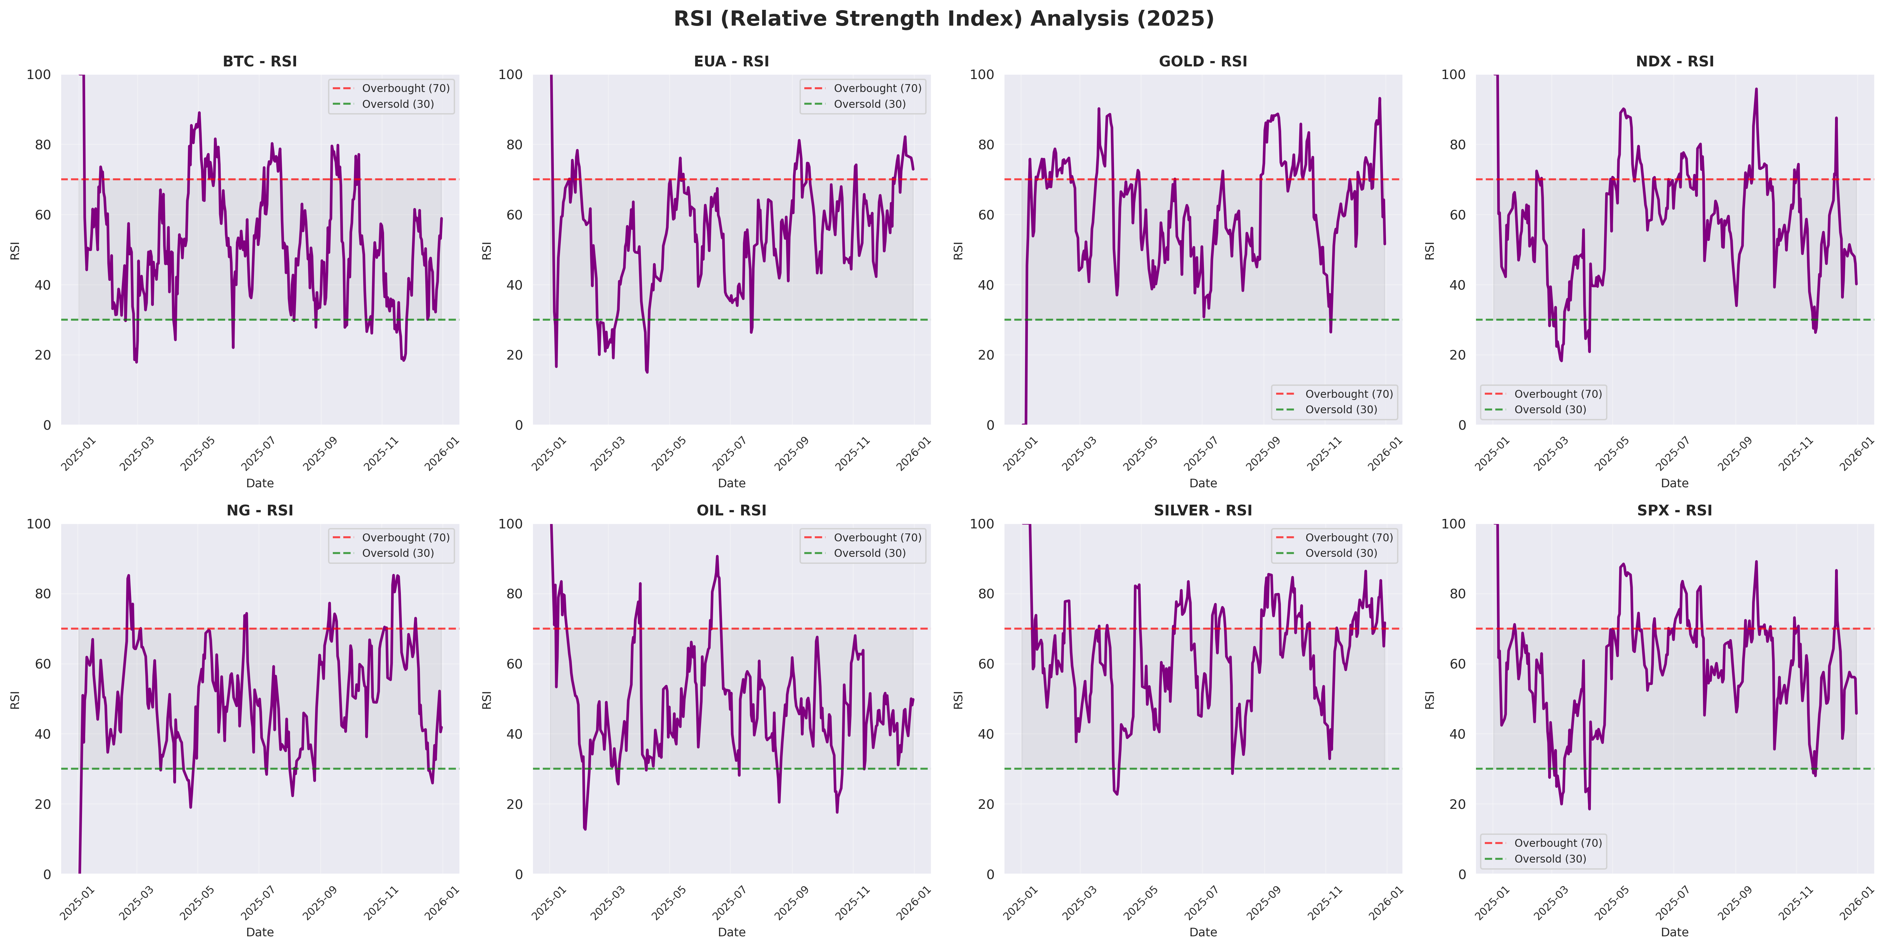

Slide 9
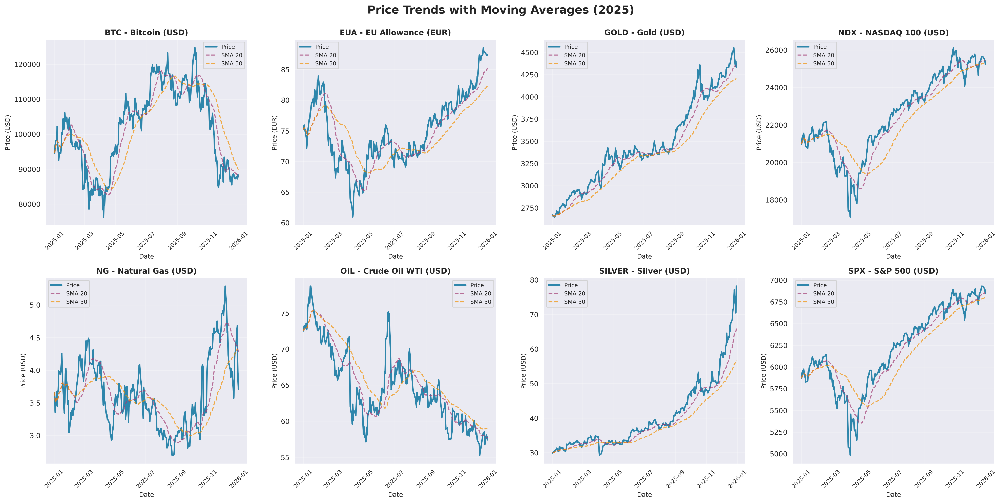

Slide 10
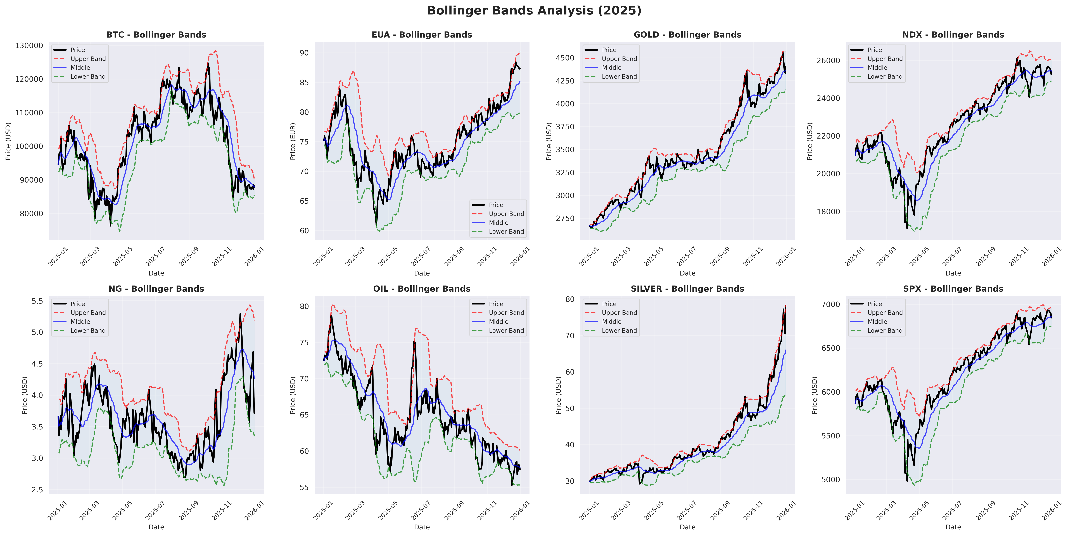

Slide 11
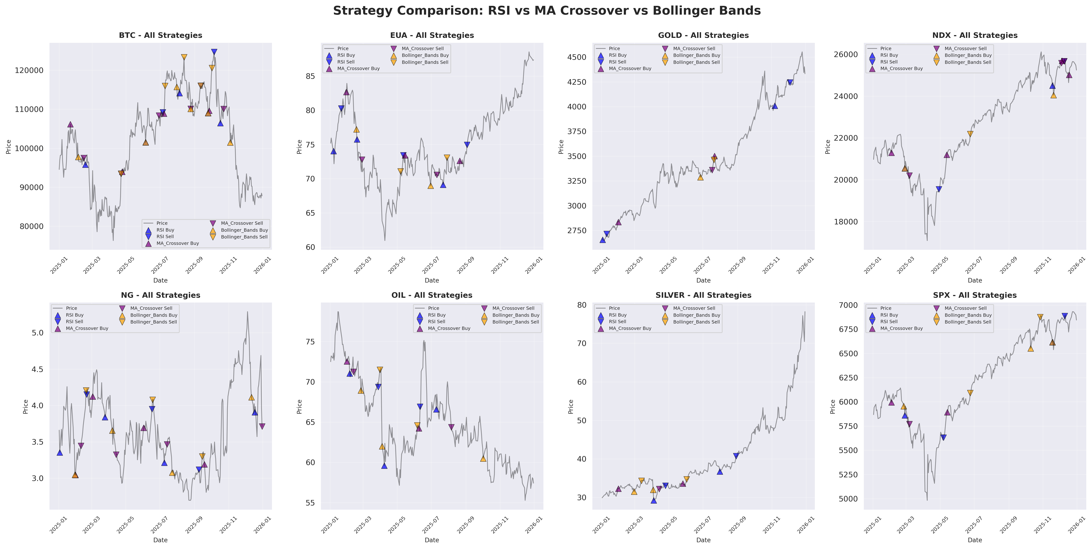

Slide 12
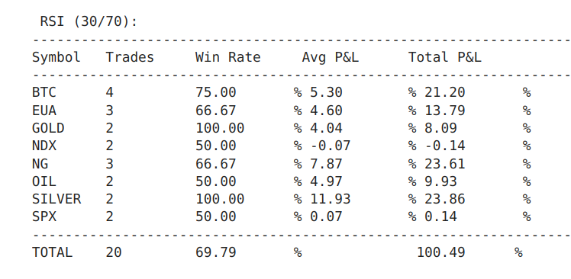
Three Strategies

Slide 13
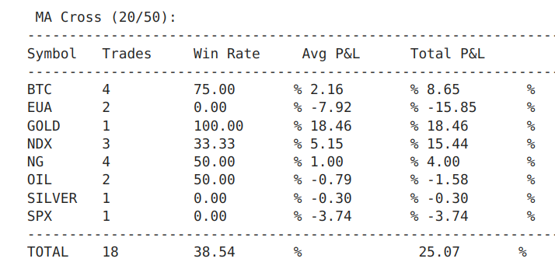
Three Strategies

Slide 14
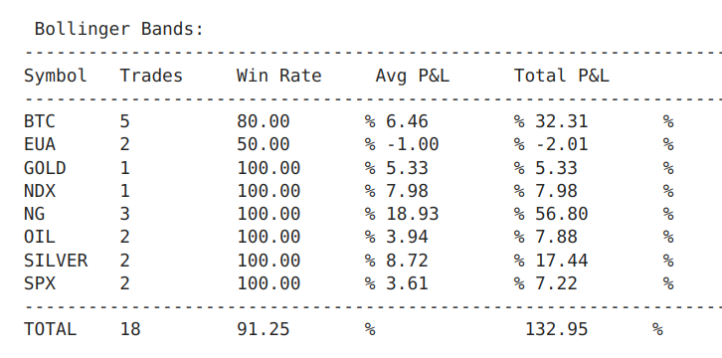
Three Strategies

Slide 15
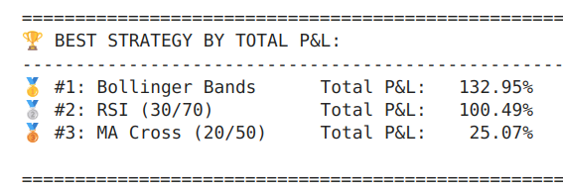
Three Strategies

Slide 16
Dashboard Demo
INTERACTIVE DASHBOARD (Streamlit)
4 PAGES:
1. Market Overview - All 8 prices, performance chart
2. Technical Analysis - Moving averages, RSI, Bollinger Bands
3. Strategy Backtest - Test strategies with adjustable parameters
4. Statistics - Risk/return analysis
FEATURES:
- Login system
- Adjustable RSI period (5-30 days)
- Adjustable strategy thresholds
- Visual buy/sell signals
- Green shading = open positions
- Trade history table
- SQL database backend

Slide 17
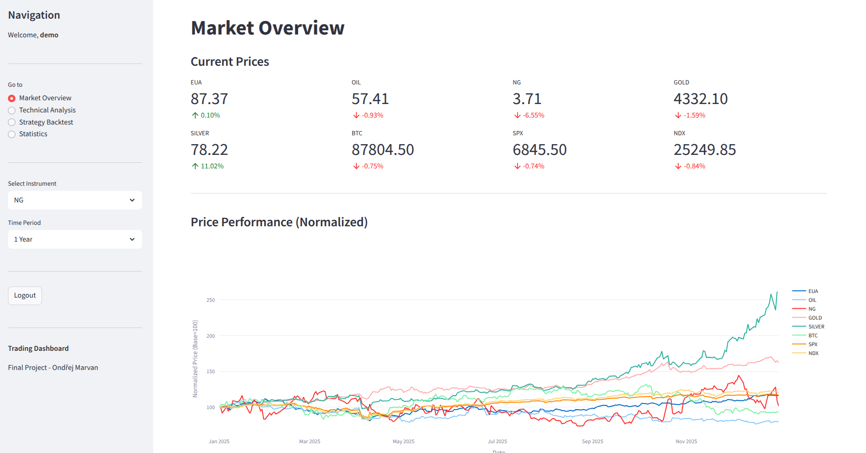
Dashboard

Slide 18
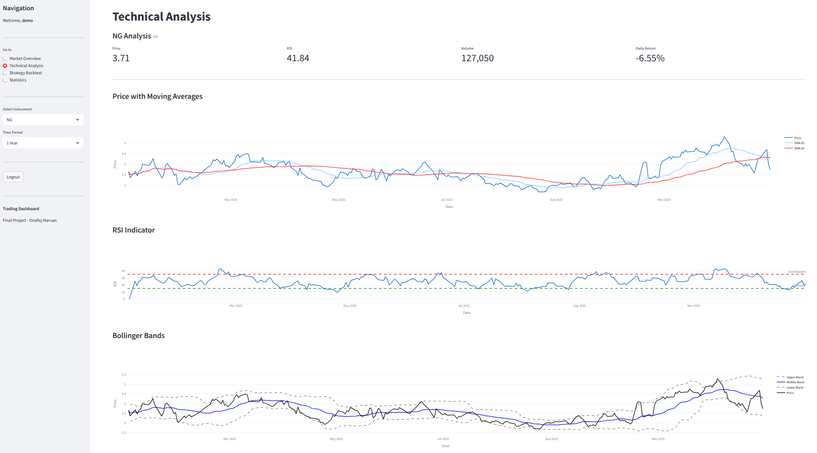
Technical Analysis

Slide 19
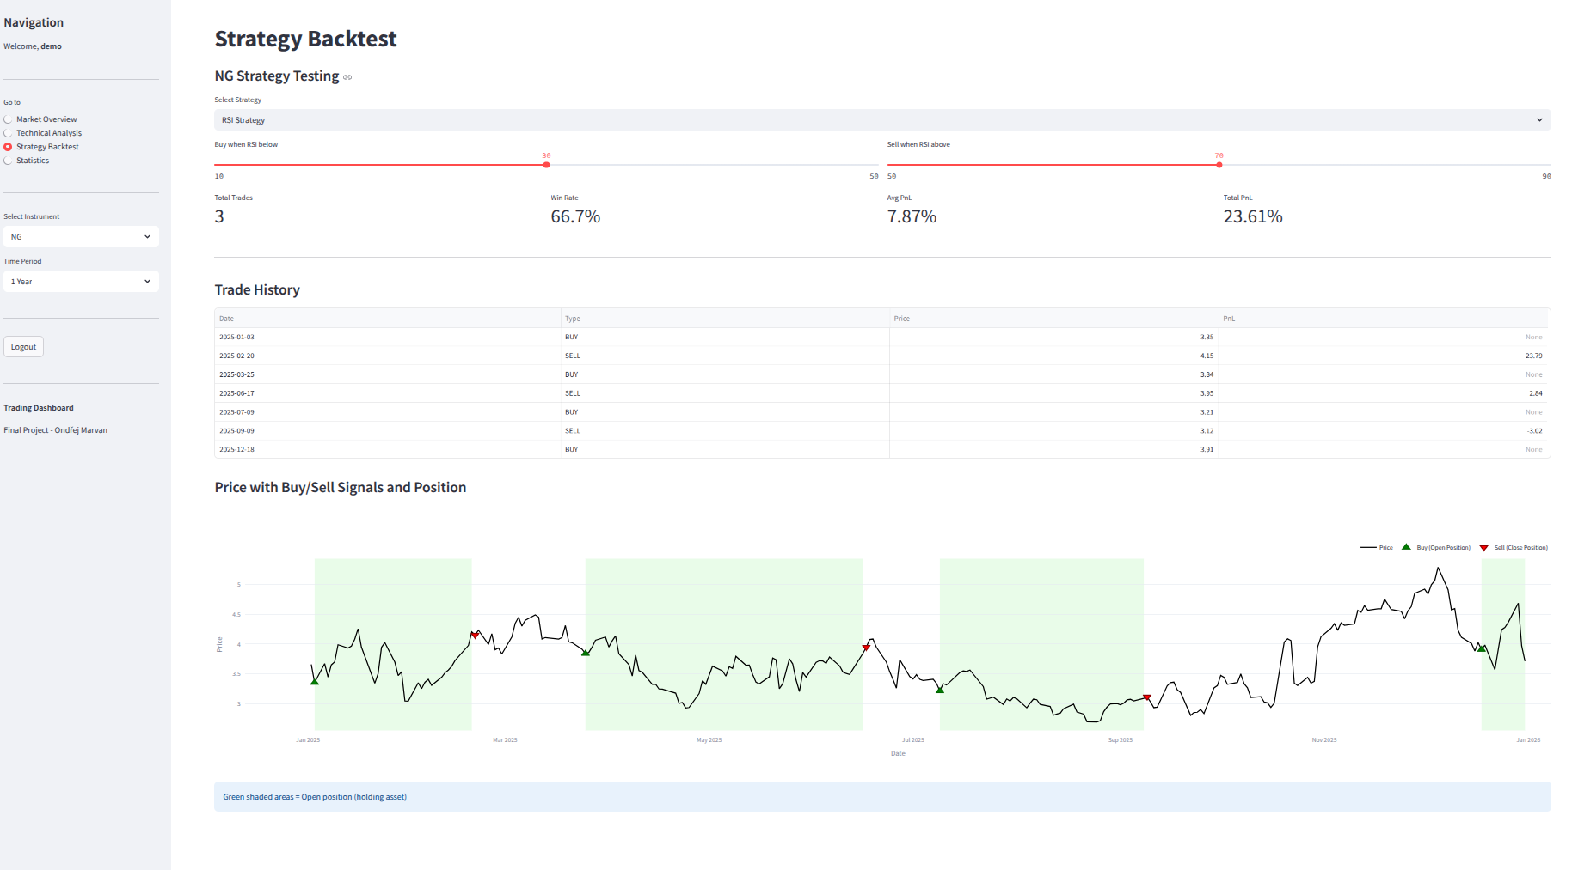
Backtest

Slide 20
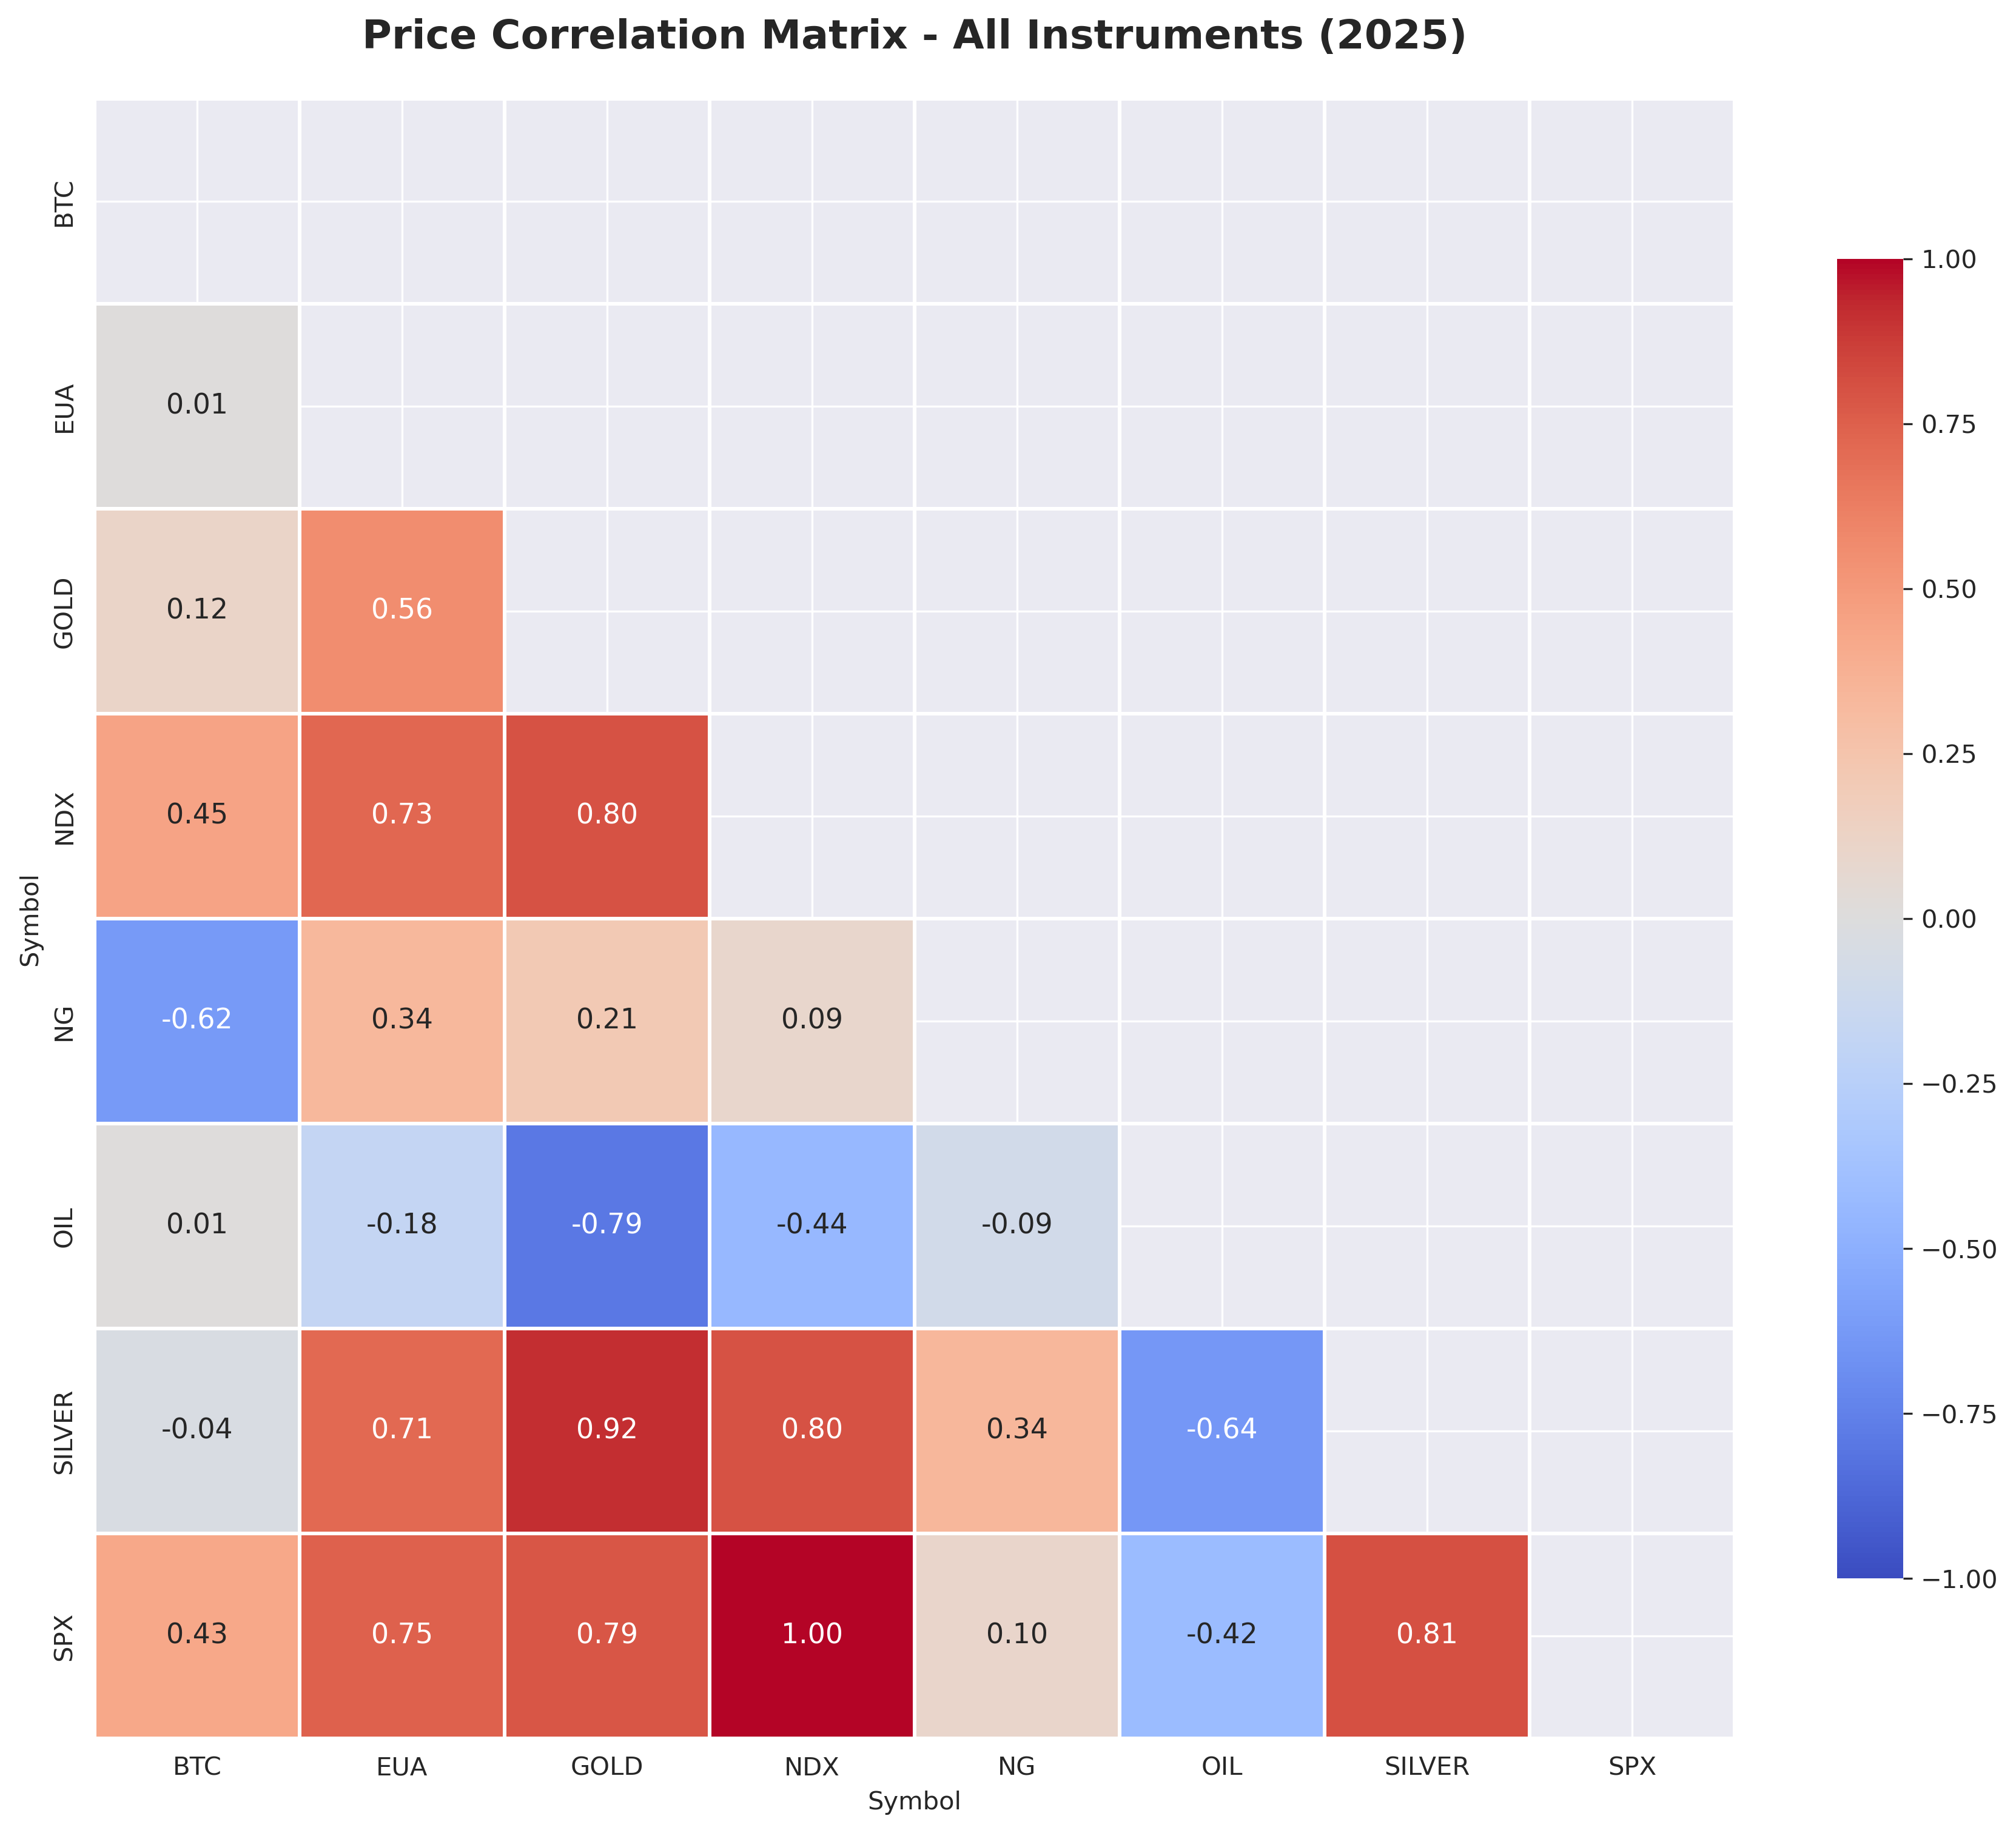

Slide 21
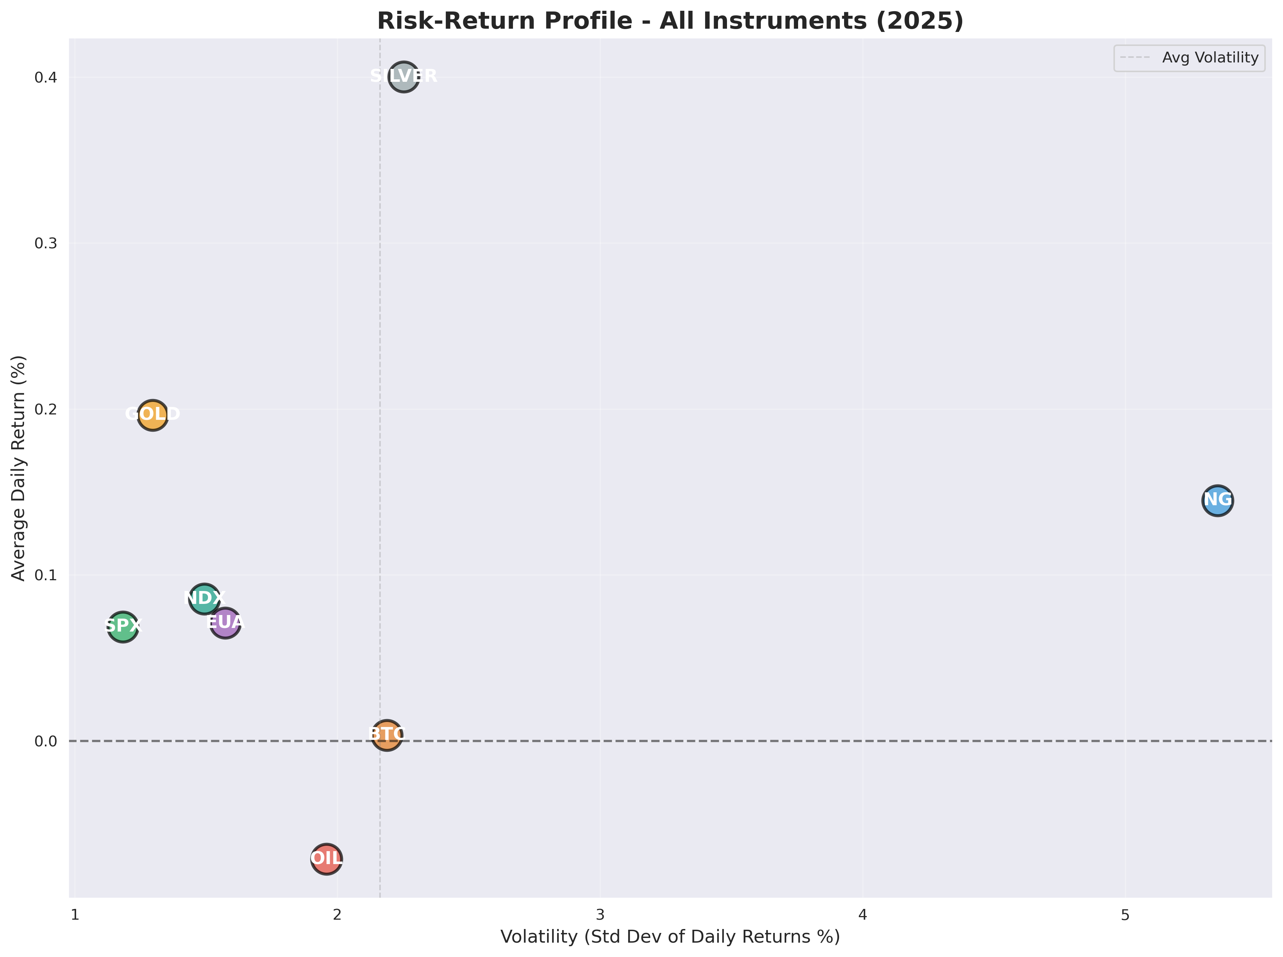

Slide 22
Conclusions
KEY FINDINGS
1. NO UNIVERSAL WINNER
Best strategy depends on asset behavior
2. STRATEGY-ASSET MATCHING
• Trending → MA Crossover
• Volatile → Bollinger Bands
• Range-bound → RSI
3. BACKTESTING IS ESSENTIAL
Test before risking real money
TECHNICAL SKILLS DEMONSTRATED
- Data cleaning (Pandas, 8 CSV files)
- Algorithm implementation (3 strategies)
- Visualization (12 charts)
- SQL database (7 tables)
- Web dashboard (Streamlit)

Slide 23
Thank you! Questions?

